Slide 1
Face-GAN: Face image enhancement using Generative Adversarial Networks

Slide 2
Introduction
In project, we are enhancing the image by converting low resolution image to high resolution image with GANS.
Generative Adversarial Networks, or GANs for short, are an approach to generative modeling using deep learning methods, such as convolutional neural networks.
Generative modeling is an unsupervised learning task in machine learning that involves automatically discovering and learning the regularities or patterns in input data in such a way that the model can be used to generate or output new examples that plausibly could have been drawn from the original dataset.
GAN are basically two neural networks fighting against each other. It consists of two networks Generator and Discriminator . Generator generates specific data and the analyst tries to predict the weather data from the input database or generator

Slide 3
Literature Review
Generative Adversarial Networks (GANs) have become a popular research area in deep learning since their introduction in 2014.
Year | Method / Architecture | Problem Description | Author
2015 | DCGAN | used deconvolutional layers in generator and convolutional layers in discriminator to generate high-quality images. | Alec Radford and Luke Metz
2018 | StyleGAN | use adaptive instance normalization and progressive growing to generate even higher-quality images. | Tero Karras and Samuli Laine
2017 | WGAN | introduced a new objective function that improved the stability and convergence of the GAN training process. | Martin Arjovsky and Soumith Chintala

Slide 4
Why unsupervised GANS
Training process not require labeled data.
In supervised learning, the algorithm is trained on labeled dataset.
GANs are trained to generate new data that is similar to the training data
GANs VS CNN : GANs and CNNs are two different types of neural networks that serve different purposes.
GANs are generative models, meaning they are designed to create new data, such as images or text, while CNNs are discriminative models, meaning they are designed to classify or recognize existing data.

Slide 5
Problem description
Traditional image super-resolution techniques:
Result in images that are blurry or lack fine details
Increase the size of the image without adding any additional information or details.
Not be able to effectively handle complex image features.
May require manual intervention or parameter tuning

Slide 6
SO why use GAN for image resolution
GANs can generate realistic and high-quality images.
GANs can handle complex image features.
GANs can be combined with other neural network architectures
.
GANs can learn from unlabeled data, which is often available in image super-resolution tasks.

Slide 7
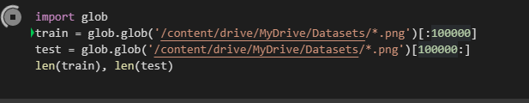
DATASEt
Data set Name | CelebFaces Attributes (CelebA) Dataset
Total Images | over 200000
Train Images | 85%
Year | Last Updated in 2018
Test Images | 15%
Source | Kaggle
Data Acquisition: In our project, the data acquisition is being done using the `glob ` function provided by TensorFlow.

Slide 8
Project scope
This project is related to face so, it is limited to generate high resolution image of faces only.
Collecting a dataset of low-resolution face images, Preprocessing the dataset, Training a GAN model, Evaluating the performance of the GAN model
Develop web application for image resolution
It is widely used in various fields.

Slide 9
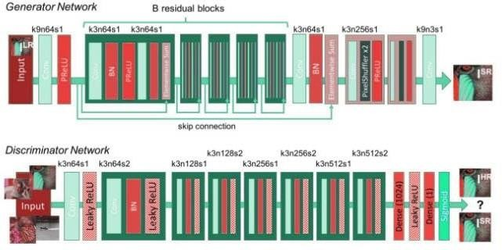
Methodology
During the training, A high resolution image is converted into low-resolution image and then Generative adversarial network upgrade low resolution images to super-resolution then discriminator will distinguish the high resolution images and backpropagate the adversarial network loss to train both the discriminator and generator. Below is the network design for the generator and the discriminator. It mostly composes of convolution layers and parameterized ReLU.

Slide 10
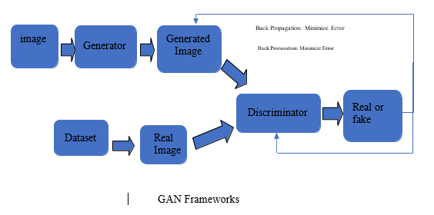
Methodology

Slide 11
How to Train
Training GANs involves the following steps:
Preparing the Dataset
Defining the G and D Network
Training the GAN
Optimizing the GAN
Evaluating the GAN

Slide 12
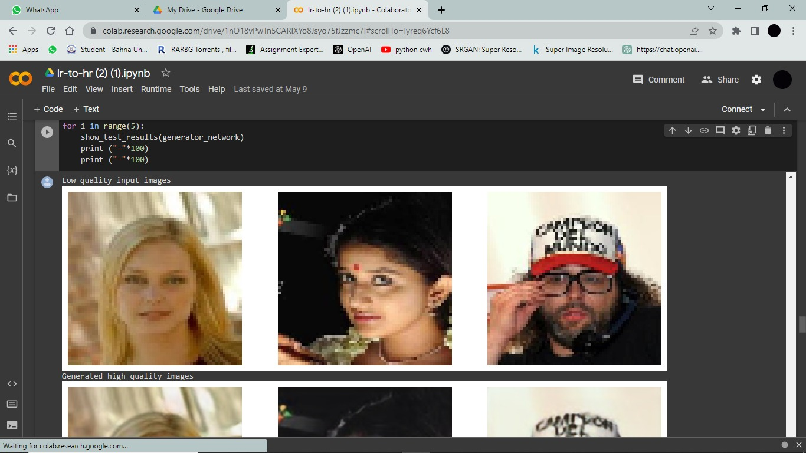
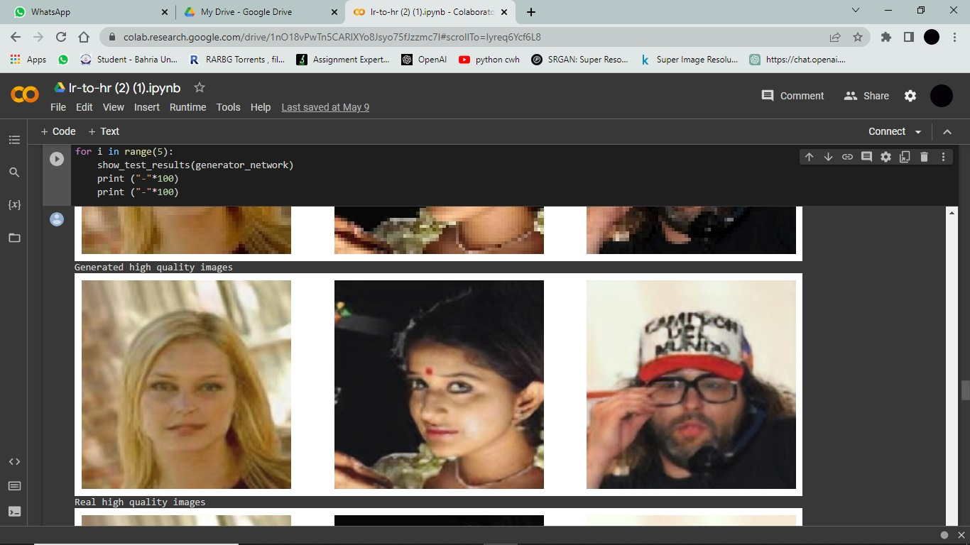
Some results from our trained model

Slide 13
Tools and technologies used
Language | python
Framework and libraries | Tensorflow , keras , Matplotlib, Flask, Numpy , pandas , Open CV
Notebook | Kaggle code and Google collab
IDE | PyCharm

Slide 14
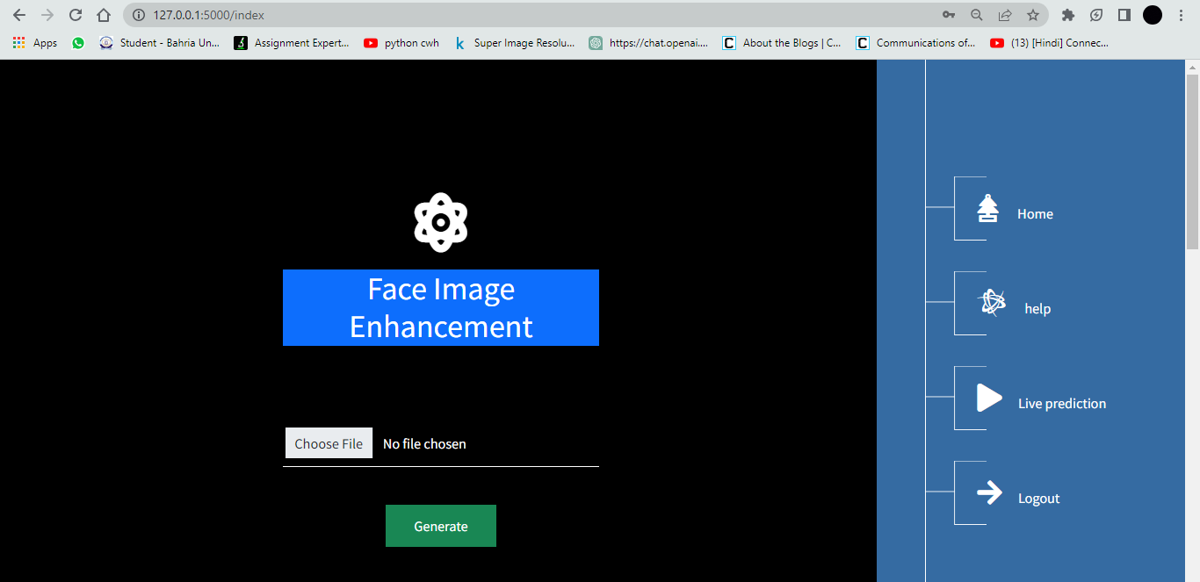
User interface
The trained GANs model has been integrated in a flask-based web application.
The project runs in real-time. UI allows user to upload LR image and give HR image.

Slide 15
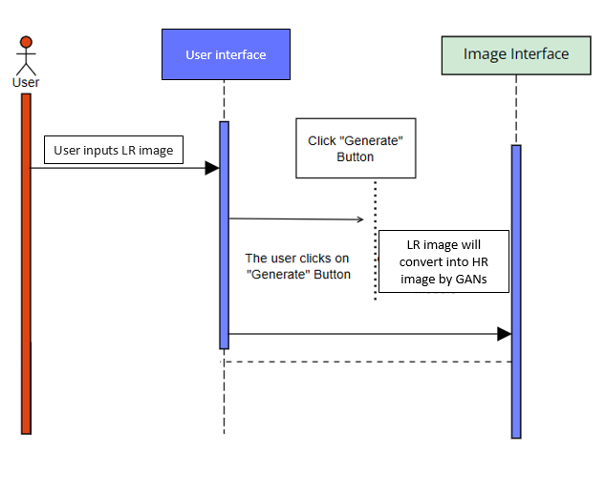
Sequence Diagram

Slide 16
Thank you

